Slide 1
World happiness report 2021
https://www.kaggle.com/ajaypalsinghlo/world-happiness-report-2021

Slide 2
Background
The Gallup World Poll conducted a worldwide survey to find our how happy the people are. The values are obtained from 6 factors namely income, family social support, healthy life expectancy, freedom to make choices, sense of generosity, perception of corruption in government.
The score is summarised into a single aka ‘happiness score’.
The purpose of the report is to compare regional blocs of countries in all the 6 factors in relations to ‘happiness score’.
To rank South East Asia countries in terms of ‘happiness score.’

Slide 3
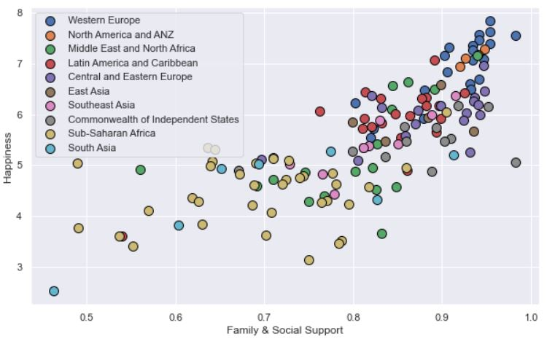
How does family & social support relates to Happiness?
Family & social support & Happiness scores are relatively high in developed countries in Western Europe, N. America, Australia, New Zealand.
However in South Asia, Sub-Saharan Africa, East Asia, the scores are relatively low.
The middle comes from South East Asia, Latin America and Central and Eastern Europe.
There is a STRONG relationship between Family & social support and happiness as indicated by the ‘RED’ arrow.
Correlation of 0.75

Slide 4
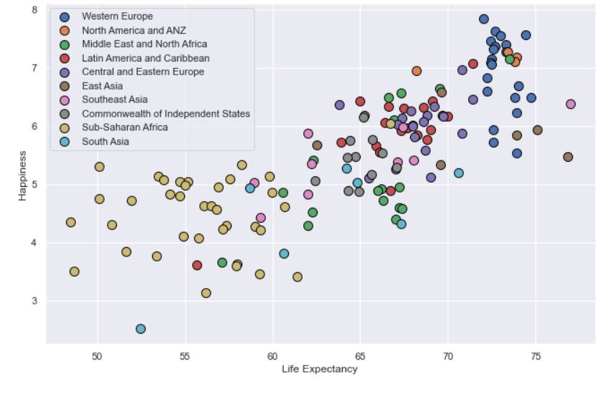
How does a healthy life expectancy relates to Happiness?
Developed nations in Western Europe, N. America, Australia and New Zealand scores high in healthy life expectancy and happiness.
Sub-Saharan Africa lacks behind.
The middle of the road consist of Latin America, Central & Eastern Europe, East Asia, South East Asia and Middle East and North Africa.
There is a STRONG relationship between healthy life expectancy and happiness as indicated by the ‘RED’ arrow.
Correlation of 0.77

Slide 5
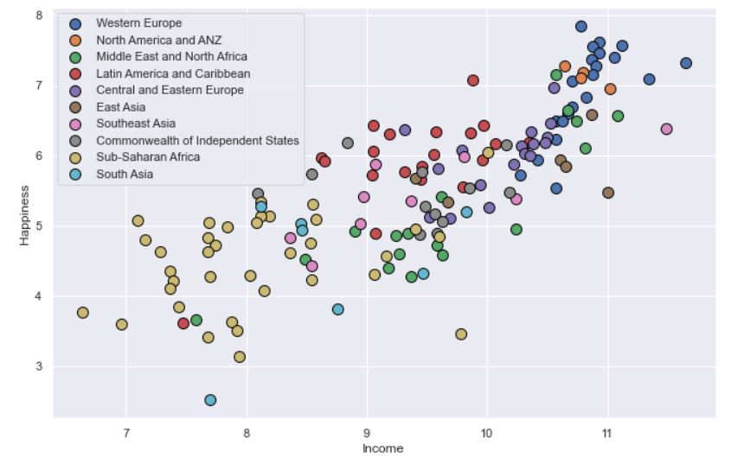
How does a income relates to Happiness?
Western Europe, N. America, some Middle Eastern, N. African countries, Central and Eastern Europe scores high in income and happiness.
Sub-Saharan Africa, South Asia scores low.
The middle ones are Latin Amercia, Middle East, East Asia and South East Asia.
There is a STRONG relationship between income and happiness as indicated by the ‘RED’ arrow.
Correlation of 0.79

Slide 6
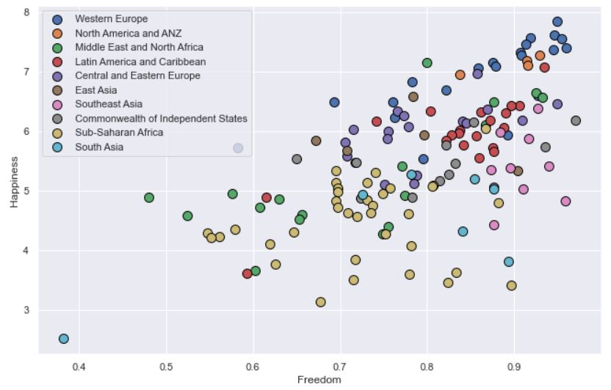
How does a freedom to make choices relates to Happiness?
Western Europe, N. America, Australia and N. Zealand, Latin America scores relatively higher in freedom, happiness scores.
Sub-Saharan Africa and Middle East and N. Africa scores are across a wide spectrum but do not contribute to happiness.
Middle ones are Central and Eastern Europe.
South Asia scores high in freedom to make choices, but do not contributes to happiness.
There is a MILD relationship between freedom and happiness as indicated by the ‘PURPLE’ arrow.
Correlation of 0.60

Slide 7
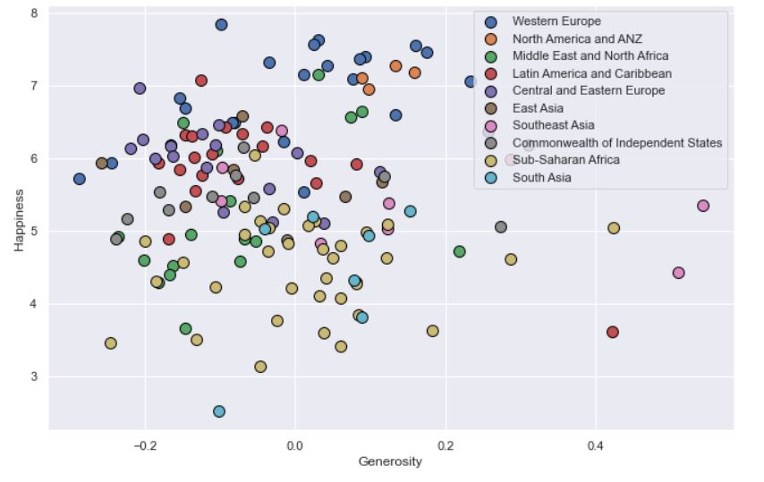
How does a generosity relates to Happiness?
South East Asia scores higher relatively in generosity but do not contribute to happiness.
The rest scores relatively low to negative in generosity.
There is a NEGATIVE relationship between generosity and happiness as indicated by the ‘PURPLE’ arrow.
Correlation of -0.017

Slide 8
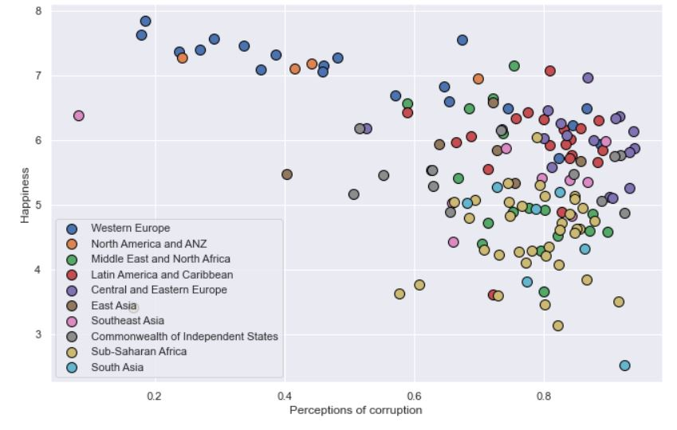
How does a perception of corruption in government relates to Happiness?
Western Europe, N. America, Australia and N. Zealand scores lowest on perception of corruption in government, and scores high on happiness.
The rest scores between the middle and high spectrum and scores relatively average in happiness.
We see a NEGATIVE relationship between perception of corruption and happiness as indicated by the ‘PURPLE’ arrow.
Correlation of -0.42

Slide 9
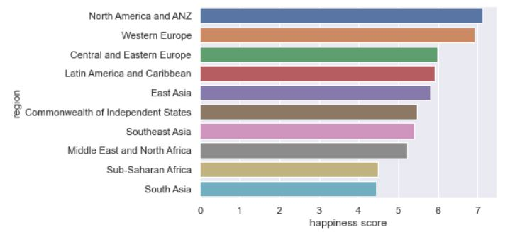
Ranking of happiness scores
This is the ranking of overall happiness scores.
N. America, Australia, N. Zealand and Western Europe maintains a wide margin as compared to the rest of the countries.
South Asia lacks behind by almost 40% behind N. America.

Slide 10
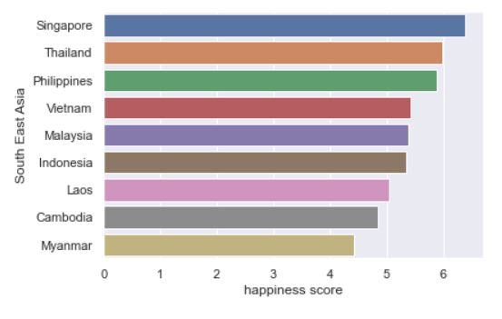
How does S.E.Asia countries rank?
Singapore ranks high in terms of happiness score.
Myanmar ranks lowest with the current situation in the country.

Slide 11
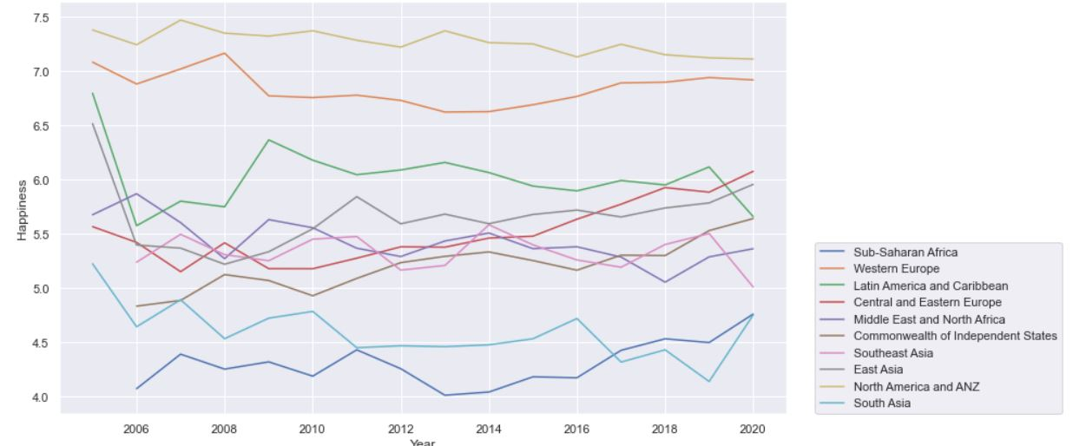
Timeline for happiness score from 2005 to 2020
In 2020, N. America, Australia and N. Zealand scores the highest, follow by Western Europe. And is consistently high in the last 15 years.
Latin America, Central & E.Europe, S.E.Asia, E.Asia and Middle East., Commonweath of states are consistently average.
South Asia and Sub-Saharan Africa are consistently ranking the lowest of all.

Slide 12
Summary and conclusion
Developed nations with high GDP per captita scores high in the 6 factors and high in Happiness with N.America, Australia, N. Zealand and Western Europe leading.
The under developed nations with low GDP per capita namely the Sub-Saharan Africa and South Asia scores the lowest in Happiness.
Developing nations such as S.E.Asia, East Asia, Latin America etc has average scores in Happiness

Slide 13
Summary and conclusion (con’t)
In order to increase Happiness, there is need to increase these 4 factors which have high weightage and strong links with Happiness:
Family & social support
Healthy life expectancy
Income
Freedom to make life choices
There is a need also to fix the perception of these 2 factors which have negative effects on Happiness:
Perception of Generosity
Perception of corruption and trust in government machineries

